Slide 1
Origins of man
Ch 1: Bulliet

Slide 2
Before Civilization
Food gathering and stone tools
“Stone Age” lasted 2 million years ago-4000 years ago.
Paleolithic (-10,000 years ago)
Neolithic
Diet foraged vegetables more than meat
Fire- 1-1.5 million years ago but evidence of cooking (clay pots) about 12,500 years ago

Slide 3
Development of hominids
Animals adapt themselves to environment
Hominids adapt environment to themselves
Use of tools
Language
Complex cooperative social structures
“The southern ape” – despite name, a hominid, Australopithesus
Discovery of skeleton AL-288-1, north of Addis Ababa, Ethiopia
Nicknamed “Lucy”
3’5”, 55lb., bipedal, brain 500 cc (modern human: 1400 cc), limited speech but opposable digit

Slide 4
Homo erectus, “upright walking human”
Larger brain capacity (1000 cc), improved tool use, control of fire, ability to communicate complex ideas
Homo sapiens, “consciously thinking human”
Largest brain, esp. frontal regions
Most sophisticated tools and social organization; flexible language
Migrations of Homo erectus and Homo sapiens

Slide 5
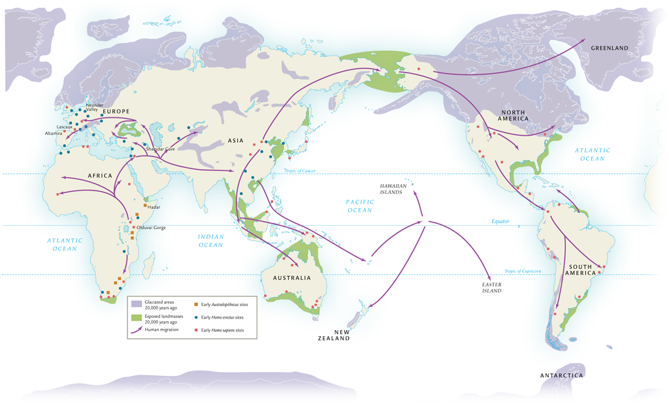
Global migrations

Slide 6
By 13,000 B.C.E., Homo sapiens in every inhabitable part of the world
Archaeological finds:
Sophisticated tools
Choppers, scrapers, axes, knives, bows, arrows
Cave and hut-like dwellings
Use of fire, animal skins
Hunted several mammal species to extinction
Climatic change may have accelerated process
Evidence:
Archaeological finds
Extrapolation from modern hunter-gatherer societies
Nomadic existence precludes advanced civilization
Division of labor along gender lines

Slide 7
Relative social equality
Nomadic culture precludes accumulation of land-based wealth
Relatively egalitarian existence
More likely determinants of status: age, hunting skill, fertility, personality
Possible gender equality related to food production
Men: protein from hunting
Women: plant gathering
Evidence of intelligent coordination of hunting expeditions
Development of weaponry
Animal-skin disguises
Stampeding tactics
Lighting of fires, etc., to drive game into kill zones
Required planning, communication

Slide 8
Paleolithic settlements
Natufian society
Modern Israel and Jordan
Wild wheat, herding
Jomon society
Japan
Wild buckwheat, fishing
Chinook society
Pacific northwest
Berries, acorns, salmon runs
Groups of 1000 or more

Slide 9
Neandertal Peoples
Neander valley, western Germany
Flourished in Europe and southwest Asia, 200,000 to 35,000 years ago
Also found in Africa, east Asia
Evidence of spirituality: ritual burial
Inhabited some of the same areas as Homo sapiens

Slide 10
Creativity of homo sapiens
Constructed flexible languages for communication of complex ideas
Increased variety of tools – stone blades, spear throwers, sewing needles, barbed harpoons
Fabricated ornamental beads, necklaces and bracelets
The bow and arrow – a dramatic improvement in humans’ power over nature
“Venus” figurines
Cave paintings

Slide 11
Neolithic era-”new Stone age”
Distinction in tool production
Chipped vs. polished
Relied on cultivation for subsistence
Men: herding animals rather than hunting
Women: nurturing vegetation rather than foraging
Spread of agriculture
Slash-and-burn techniques
Exhaustion of soil promotes migration
Transport of crops from one region to another

Slide 12
Agricultural revolutions
“domestication of plants and animals” as a series of changes in food production in various parts of the world
Climate changes had a role
1st stage: semicultivation-scattering of seeds
2nd stage: slash and burn to clear fields, use of tools to harvest and clear
First evidence in ME, also ev in Eastern Sahara, Nile Valley, Greece, Central Europe
Practice swidden agriculture: use and move on

Slide 13
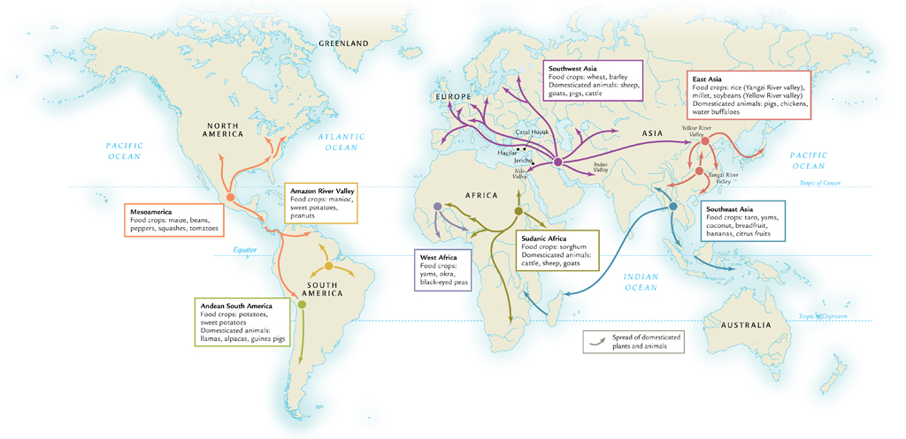
Origins & Early spread of agriculture

Slide 14
Environment influenced choice of crops: Mediterranean: Wheat and barley
Sub-Saharan: millet, sorghum, teff
Equatorial West Africa: yams
Eastern & Southern Asia: rice
Americas: maize, potatoes, quinoa, manioc
Domestication of animals- dogs first, goats and sheep
Significant increase in world population
5,000BCE 10 million - 1,000BCE 50-100 million

Slide 16
Life in Neolithic Communities
Use megaliths (big stones) to construct burial chambers, calendar circles, astronomical observations
Most live in villages, some towns
More elaborate living, food storage, evidence of craftman
Jericho-west bank of Jordan River- walled, made mud bricks, 8,000BCE
Catal Huyuk-Anatolia, center obsidian trade, craftsmen, no ev of class society or politics, 7,000-5,000BCE

Slide 17
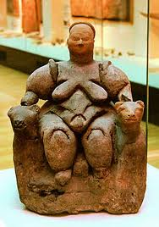
Catal Huyuk art fascination with hunting, agricultural mainstay of economy
Religion based on offerings of food to a goddess, administered by priestessess
Ceremonial objects of copper, lead,
silver, and gold
Tools still made of stones

Slide 18
What is civilization?
Urban-cities as administrative centers
Political/military system-based on control of a defined territory rather than kinship connections
Social stratification-status distinctions based on the accumulation of wealth by some groups
Economic specialization-specialized, non-food producing activities
Monument building
Major advances of arts and sciences
Communications-a system for keeping permanent records
Long distance trade

Slide 19
culture
Learned patterns of action and expression
Includes material objects, such as dwellings, clothes, tools and crafts
Nonmaterial values, beliefs, languages
The development, transmission, and transformation of cultural practices and events are subject of history

Slide 20
mesopotamia
Alluvial plain between Tigris and Euphrates
Little rainfall, rivers flood wrong times for grain agriculture, change course unpredictably
4,000BCE using cattle-pulled plows, barley
3,000BCE irrigation canals
Sumerians earliest people 5,000BCE
Replaced by Semitic-speaking people who intermarry and dominate

Slide 21
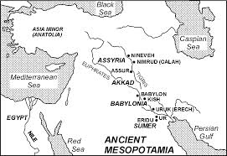
map

Slide 22
Cities, kings & trade
Early society villages and cities linked by mutual interdependence (food—crafts,markets,protection)
City-state: city + agricultural hinterlands
Sometimes fight over resources like water and land
Mobilize manpower to build canals=require large labor force
Lugal (big men) emerge as secular leaders, thought from military. Rule from palaces and take over control of religious institutions. Epic of Gilgamesh.
Some city-states grow powerful and absorb others, leading to large territorial states: Akkadian (Sargon) 2,350BCE, Third Dynasty of Ur (2,112-2,004BCE)

Slide 23
Later empires
Weakening of central rule an invitation to foreign invaders
Assyrians use new iron weaponry
Beginning 1300 B.C.E., by eighth to seventh centuries B.C.E. control Mesopotamia, Syria, Palestine, most of Egypt
Nebuchadnezzar of Babylon (r. 605-562) takes advantage of internal dissent to create Chaldean (New Babylonian) empire
Famously luxurious capital

Slide 24
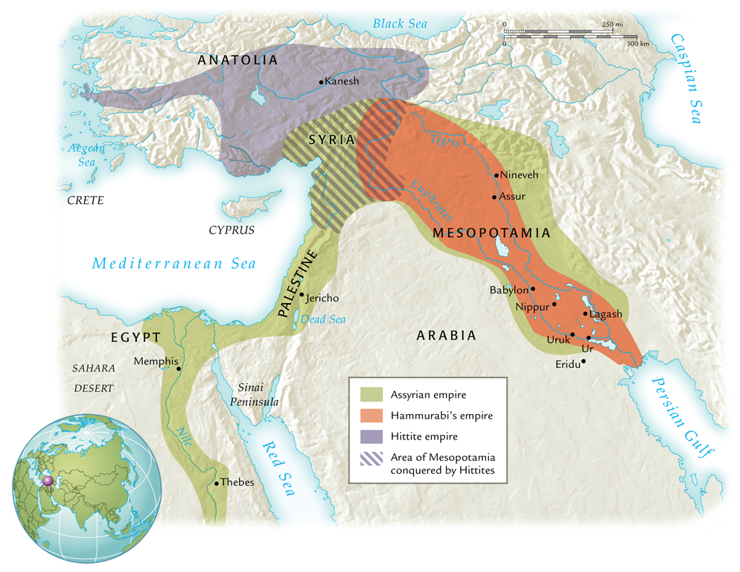

Slide 26
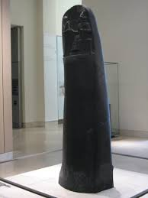
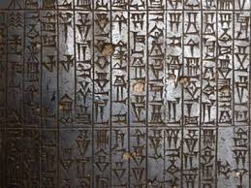
Hammurabi leader of Babylon
Source of evidence on law code, punishments and society
Stele

Slide 27
Mesopotamian society
Long distance trade develops. Originally merchants employed by temples & palaces, but later second millennium BCE private merchants emerge
Trade is by barter
Society is stratified. Kings and priests control most wealth.
1. free land owning class
2. dependent farmers and artisans
3. slaves, most were prisoners of war, not a fundamental part of economy

Slide 28
Women?
Decline in role as en did value-producing work or plowing and irrigation
No political role
Can own land, control own dowry, and engage in trade
Rise of merchant class in second millennium BCE brought greater emphasis on male privilege and decline in women’s status
Introduction of veil at least circa 1,500 BCE

Slide 29
Gods, Priests & Temples
Religion mix Sumerian and later Semitic beliefs and deities
Deities are anthropomorphic
Humans are servants of the gods
Temples have a complex hierarchy and priesthood is hereditary, walled complexes
Ziggurat most visible part of complex
Little known about practices and beliefs
Evidence indicates belief in magic to influence gods

Slide 30
Ziggurat-home of god

Slide 31
Technology & science
“any specialization of knowledge that is used to transform the natural environment and human society”
Irrigation systems, nonmaterial specialized knowledge like religion, ceremony and writing systems
Cuneiform evolved from use of pictures to represent the sounds of words or parts of words.
Scribes monopolize knowledge
Starts Sumerian, but later Akkadian and other Semitic languages. Economic, political, legal, literary, religious, and scientific texts.

Slide 32
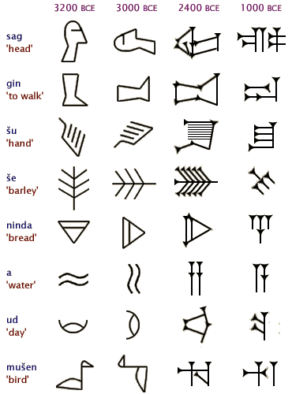
Cuneiform

Slide 33
Bronze (copper with tin), ca. 4000 B.C.E.
Military, agricultural applications
Iron, ca. 1000 B.C.E.
Cheaper than bronze
Wheel, boats, ca. 3500 B.C.E.
Shipbuilding increases trade networks
Calendar- 12 month year, 24 hour day, 60 minute hour.

Slide 34
Egypt
“Gift of the Nile”- narrow strip of land along banks, rest is desert
Upper Nile- along southern part to First Cataract
Lower Nile- northern delta area
Little rainfall, irrigation necessary, fertile soil
Floods regularly, right time of year, leaving rich silt, develops idea that universe is regular and orderly
Other natural resources: reeds (writing), wild animals, birds, fish, plentiful stone and clay for building, access to copper and turquoise, gold from Nubia

Slide 35
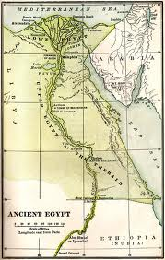
map

Slide 36
Divine Kingship
Small states grow to large empire,3,100BC unified.
30 dynasties organize time, Old, Middle & New Kingdoms
Periods of fragmentation and chaos between
Pharaohs, gods come down to earth, death is journey back, funeral rites
Early use flat topped rectangular tombs, stepped pyramids start about 2,630, smooth later
Great Pyramids of Giza constructed 2,550-2,490 BCE
Stone tools, lever and pulley, roller technology and vast human resources

Slide 37
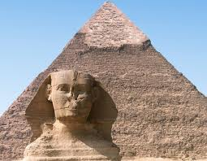
Giza

Slide 38
Politics & communication
Central administration in capital with system of provincial bureaucracy
Collect labor, taxes, and resources used to support palace, army, bureaucracy and to maintain temples and construct monuments
Hieroglyphics and cursive script. Use papyrus and use writing for religious and secular writing as well as record keeping.
Tension between central authority and provincial. Autonomous sometimes, others based merit or patronage. Hereditary roles.

Slide 39
More rural than Mesopotamia. Know little of urban life.
View foreigners as enemies but desert is a natural defense so not many enemies.
Want to acquire resources, not territory, use trade.
Trade directly with Nubia and the Levant, indirectly with other areas of Africa such as Punt.
Export papyrus, grain and gold
Import Nubian gold, incense, Lebanese cedar, tropical African ivory, ebony and animals

Slide 40
People of egypt
Population 1-1.5 million.
Heterogeneous, some light skinned, some dark
Social strata:
1. King and high ranking officials,
2. lower-level officials, local leaders and priests, professionals, artisans, well-off farmers
3. peasants- majority of population, live in villages, cultivate soil, pay taxes and provide service.
Paintings shown women subservient, engage domestic activities. Own land, inherit and will property, rights to dowry after divorce. Greater than Mesopotamia.

Slide 41
Belief & knowledge
Religion based on cyclical view of nature.
Sun god Re
Osiris god of Underworld-killed, dismembered, restored to life
Kings associated with Re and Horus (son) chief of priests
Supreme god of Pantheon is one of capital city
Temples use huge social resources, festivals, offerings.
Little known popular beliefs: magic, afterlife

Slide 42
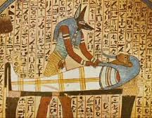
Tombs at edge desert to not use arable land.
Pictures tell about life, show social status
Knowledge: anatomy via mummification
Mathematics, astronomy, calendar, engineering and architecture

Slide 43
Indus Valley
Environment: central area Sind Valley of modern Pakistan
Indus carries silt and floods regularly twice a year
River allows for irrigation, two crops a year.
Sparse rainfall
Flourishes 2,600 BCE-1,900BCE.
Knowledge from archaeology: Harappa & Mohenjodaro
Know little of people, identity, origins or fate of population. Writing system we have yet to decipher.

Slide 44
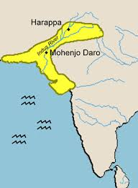
Map

Slide 45
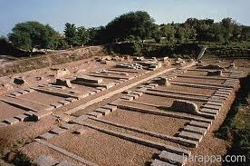
harappa
Pop 35,000
Brick walls, streets in grid pattern, covered drainage to take away waste. A citadel remains: storage? Barracks? Administration?

Slide 46
Mohenjo-daro
Population several times larger
Urban areas control surrounding farmland.
Mohenjo-Daro nexus of trade in copper, tin and precious stones from northwest.
Standardization of bricks: what is this evidence of? City planning, architecture, engineering, sign of authoritarian central government?
Better access to metal than previous civilizations-use metal for luxury goods as well as luxury items.

Slide 47
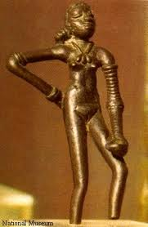
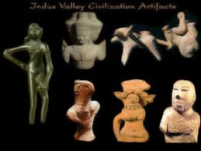
Art
Dancing girl sculpture

Slide 48
technology
Extensive irrigation systems, kiln-baked bricks, sophisticated bronze metallurgy, potters wheel, system of writing.
Trade with Iran, Afghanistan, Mesopotamia, northwest mountain area
What happened? Around 1900 BCE
Abandoned invasion?
Breakdown due to natural disaster and ecological change?

Slide 49
Ecological changes hurt agricultural production
Drying up of Hakra River, salinization and erosion
Urban centers collapse
Peasants probably adapted

Slide 50
Period 1: techonological & the peopling of the earth
1.1 big geography and the peopling of the earth
archeological evidence indicates that during the Paleolithic era, hunting-foraging bands of humans gradually migrated from their origin in East Africa to Eurasia, Australia, and the Americas, adapting their technology and cultures to new climate regions.

Slide 51
1.2 Neolithic Revolution & Early Agricultural Societies
Beginning around 10,000 years ago, the Neolithic Revolution led to the development of new and more complex economic and social systems
Agriculture and pastoralism begin to transform human societies.

Slide 52
1.3 The development & Interactions of early agricultural, pastoral, and urban societies
Core and foundational civilizations developed in a variety of geographical and environmental settings where agriculture flourished
The first states emerged within core civilizations.
Culture played a significant role in unifying states through laws, language, literature, religion, myths, and monumental art.

